Slide 1
Develop a creative recipe-generating LLM model based on user ingredients
Course: ELG5121 Multimedia Communications
Fall 2024
Taejoon Lee
300404488 tlee096@uottawa.ca
Juhi Khalid
8968922
jkhal027@uottawa.ca
Group: 8
Project Presentation submitted to Professor Abdulmotaleb El Saddik in
partial fulfillment of the requirements for the course ELG 5121/CSI7163
Student 1 Details
Student 2 Details

Slide 2
Introduction
Culinary science evolves with vast internet data availability.
Advances in NLP, powered by transformer-based LLMs, facilitate sophisticated recipe creation.
Ollama ensures fast, efficient responses at low cost.
Generates recipes based on user-entered ingredients.
Enhances user interaction by allowing users to search for recipes on Google and YouTube.

Slide 3
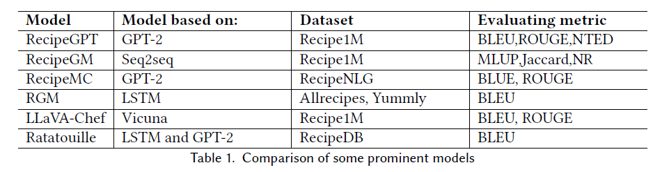
Literature review
LLMs perform better than neural networks for NLP tasks and are being used more.
OpenAI’s GPT is a strong contender for recipe generation tasks due to its advanced transformer-based architecture.
Our model uses Ollama, which is a smaller model but it is more compact and allows local deployment.

Slide 4
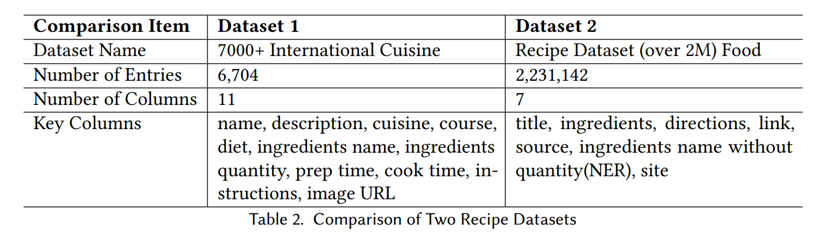
Methods and methodology
Dataset
Planned to use 2 datasets: 7000+ International Cuisine and Recipe Dataset(2M+).
Only used 7000+ International Cuisine dataset.
Limitation of computing resources.
Ease of model experimentation and performance evaluation.

Slide 5
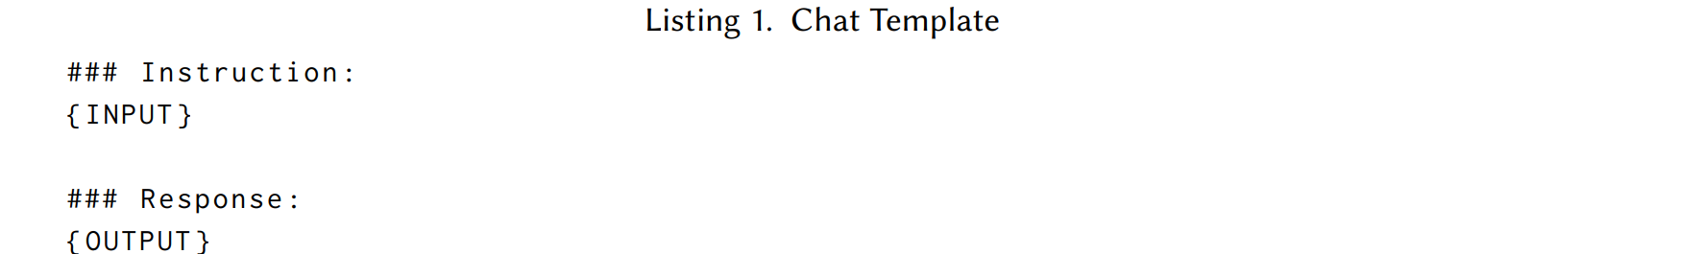
Methods and methodology
Dataset Preparation
Original dataset had multiple columns with recipe name, course, ingredient name, and ingredient quantity, which was preprocessed into two columns: instructions and the output to train the Llama model.
It was done by batching the Instruction column with “I have the following ingredients: ingredients name”, and the output column merged the rest of the columns into a single text.
ShareGPT was used to extend the simple prompt-response pair to a longer one to make the model’s response to the user’s request more interactive.

Slide 6
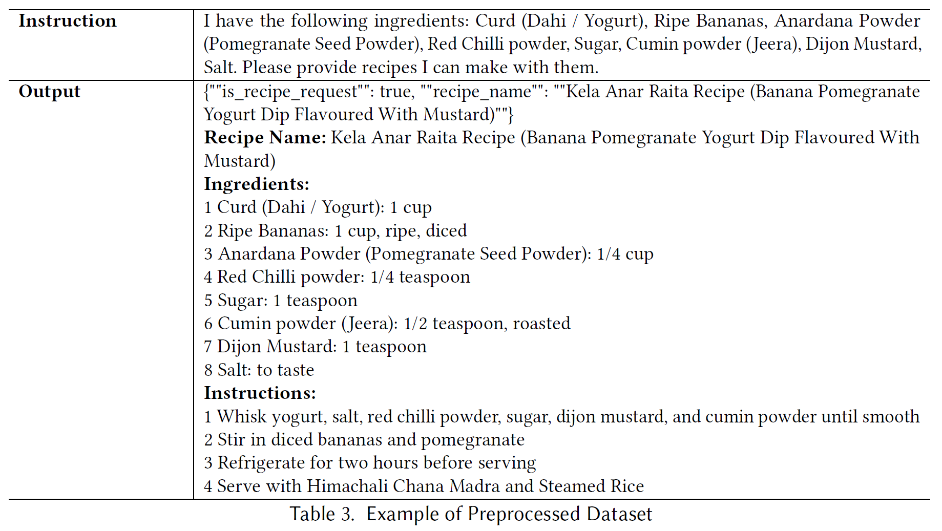
Methods and methodology
Dataset Preparation

Slide 7
Methods and methodology
Model Preparation and Fine-Tuning
Used Llama 3.2 (3B), Llama 3 (8B) [11] and Tinyllama (1.1B) .
Tinyllama (1.1B) performed poorly and was excluded from the model for the final service.
SFTrainer is a framework implemented to simplify the task of fine-tuning models using supervised learning by handling tasks such as data loading, tokenization, and training parameter management.
LoRA and Unsloth were used to optimize memory usage and computation and improve the model performance while using less memory.

Slide 8
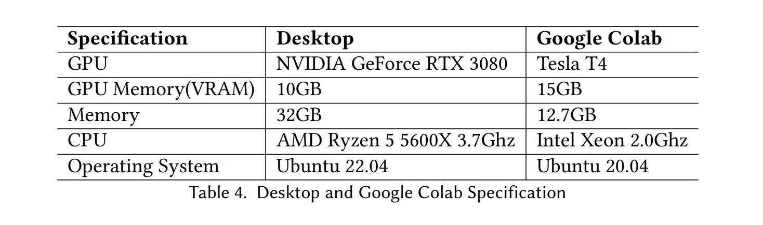
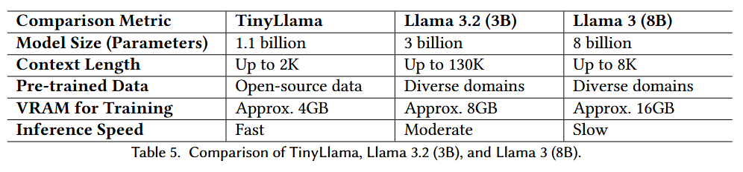
Methods and methodology
Model Preparation and Fine-Tuning

Slide 9
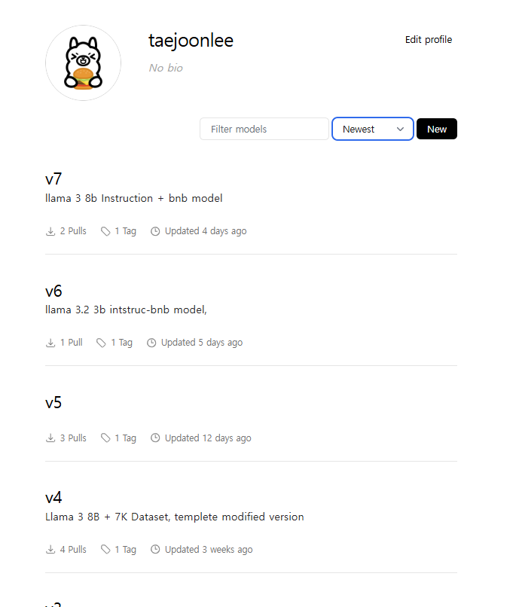
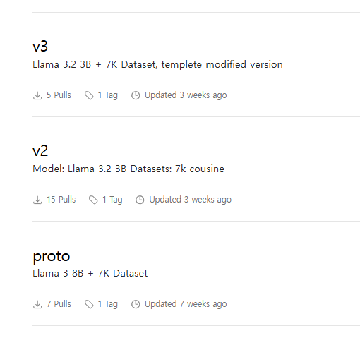
Methods and methodology
Model Preparation and Fine-Tuning

Slide 10
Methods and methodology
Backend Integration and Deployment
Open Web UI provided by Ollama is used as the interface web service.
Supports custom models and easy to deploy.
The frontend of Open Web UI is similar to the popular ChatGPT website.
Backend is implemented as FastAPI.

Slide 11
Methods and methodology
Recipe Response Logic
The model recommends recipes based on the ingredients entered by the user and links those recipes with external services(Google, YouTube).
Model can generate answers for recipe recommendations.
For external service search, it extracts only the name of the recipe. A prompt pattern forces the model to generate a structured response (e.g., in JSON format), which consists of fields like is_recipe_request, recipe_name.
When the model provides output, the backend service checks if is_recipe_request is True before responding to the user and uses recipe_name to search YouTube or Google to add the result to the user response.

Slide 12
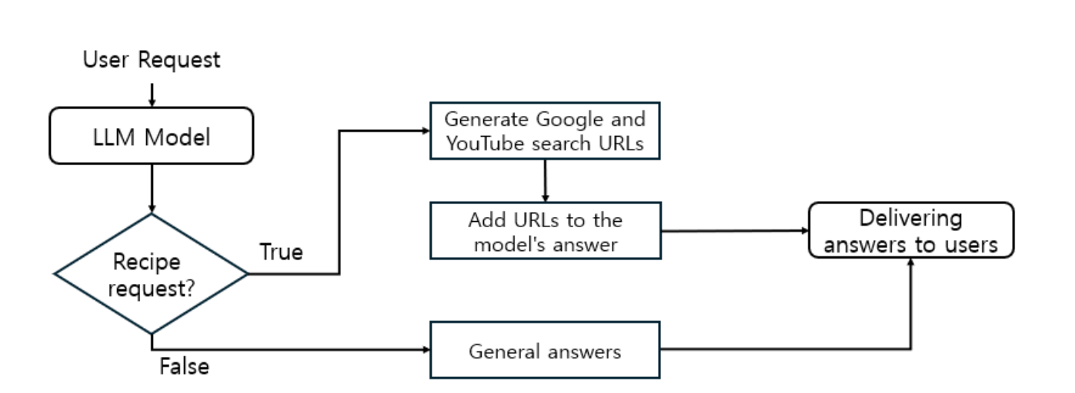
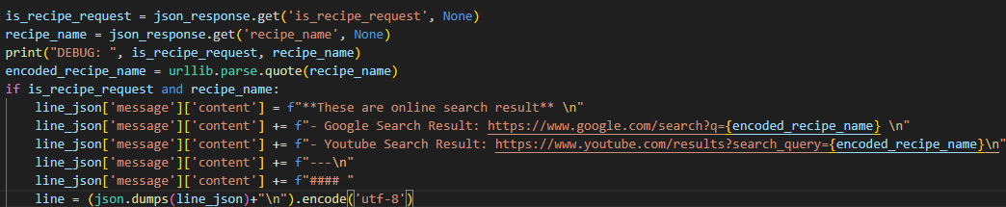
Methods and methodology

Slide 13
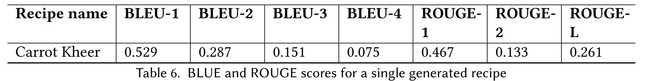
Experiments
Quantitative Evaluation
BLEU and ROUGE scores are used, which measure overlap between reference and generated texts.
BLEU is based on precision and ROUGE on recall.
Different scores depends on the n-gram level and can vary from 0-1.
For a valid performance evaluation BLEU and ROUGE scores for around 100 recipes with multiple references are required.
Due to the limitation of time and resources, only one instance is found for demonstration.

Slide 14
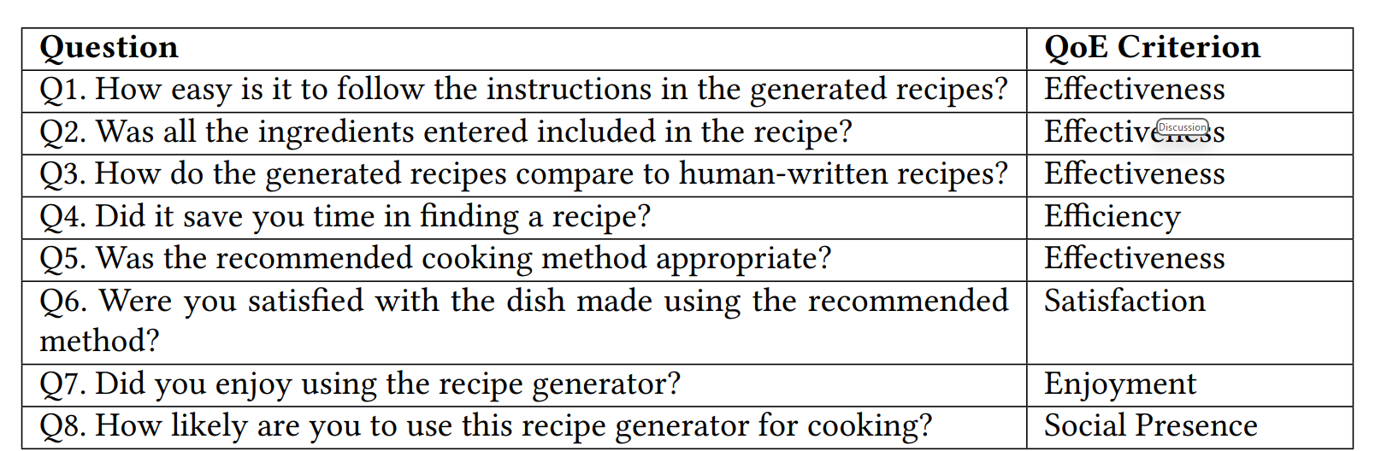
Experiments
Qualitative Evaluation
Collected survey responses from 10 participants.
QoE criteria of effectiveness, efficiency, satisfaction, enjoyment, and social presence are covered by the questions.

Slide 15
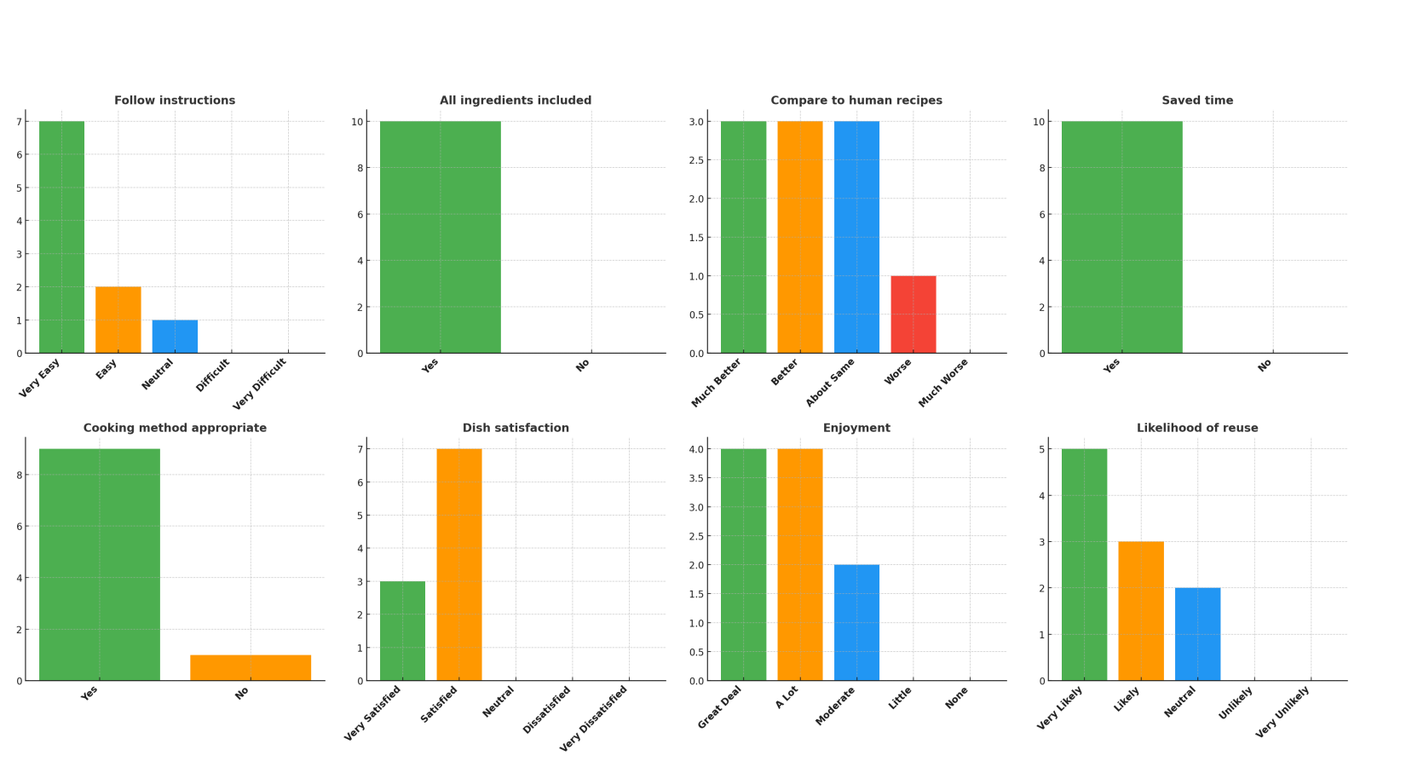
Experiments

Slide 16
Results
User Interaction with the Web UI
Connect to the Open Web UI server via a web browser and log in with their user account.
Users can choose any of the models installed on the Open Web UI server.
Choose LLama 3 (8B) model as the v7 model fine-tuned.
Write a phrase to recommend a recipe based on the ingredients they have on hand.

Slide 17
Results
Model Response Streaming
Web application provides the input to the LLM model the user selects.
It generates a response in a streaming format.
Backend checks for the presence of a JSON structure and attempts to parse it to integrate external search results.
In the logs, JSON objects like is_recipe_request and recipe_name were successfully detected and reconstructed in the model’s output.
Analysis of the Model’s Response
The model’s response followed the format of the Output structure of the dataset we defined.
The recipes generated were not trained on the dataset.

Slide 18
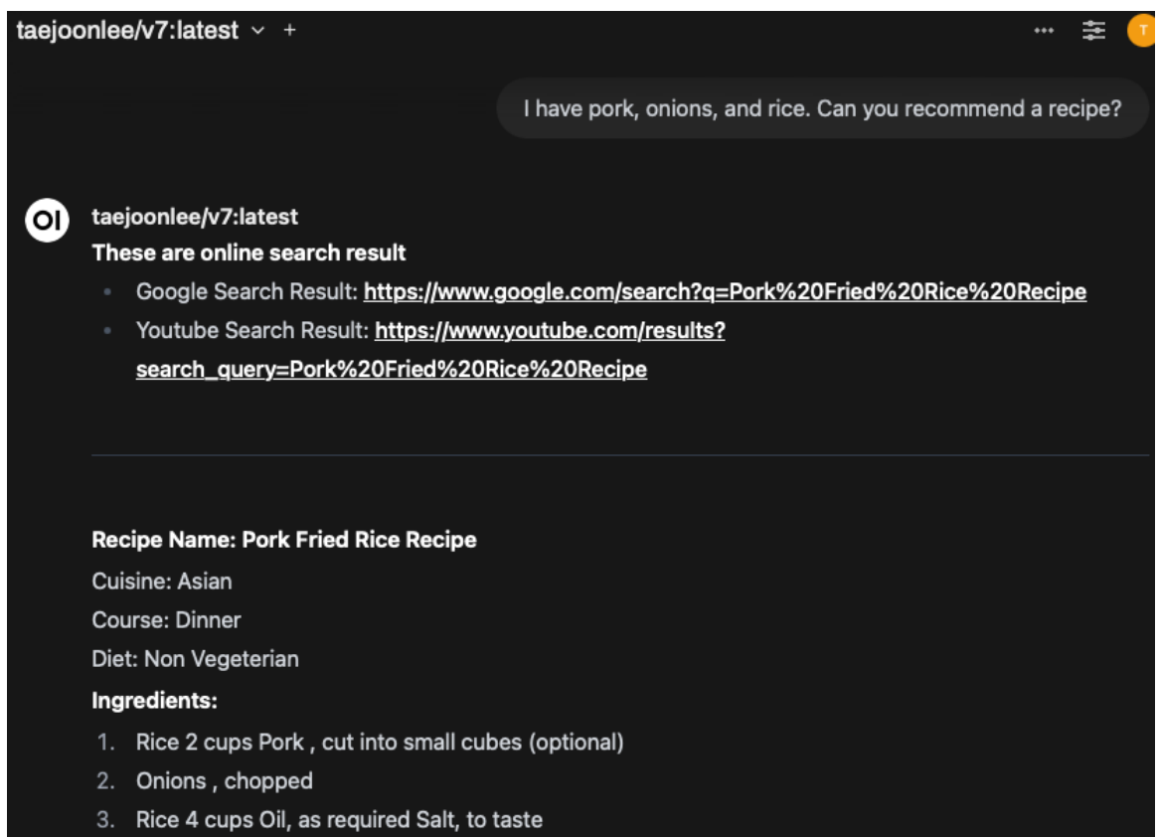
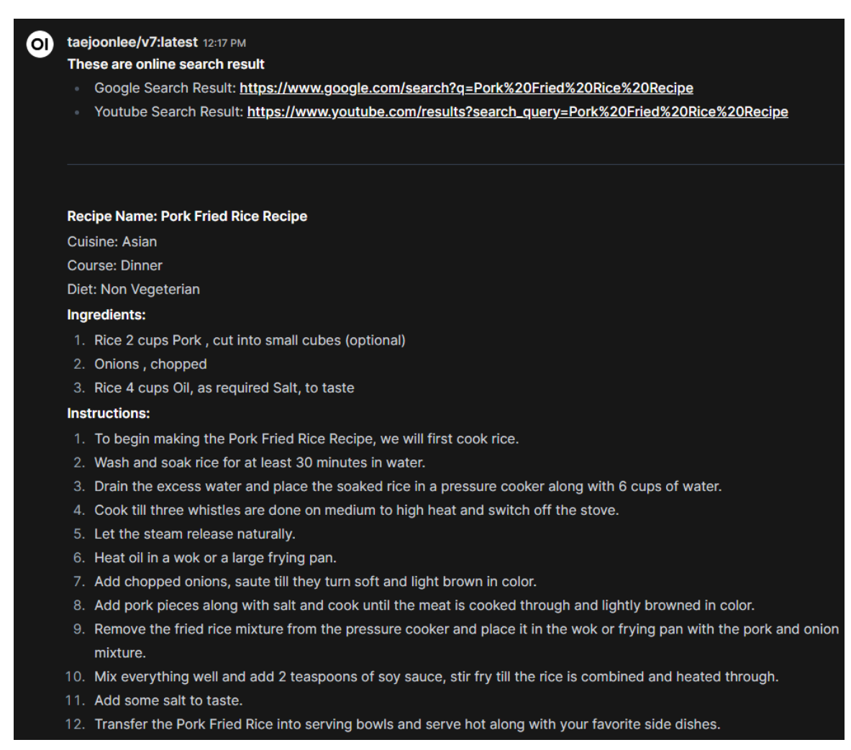
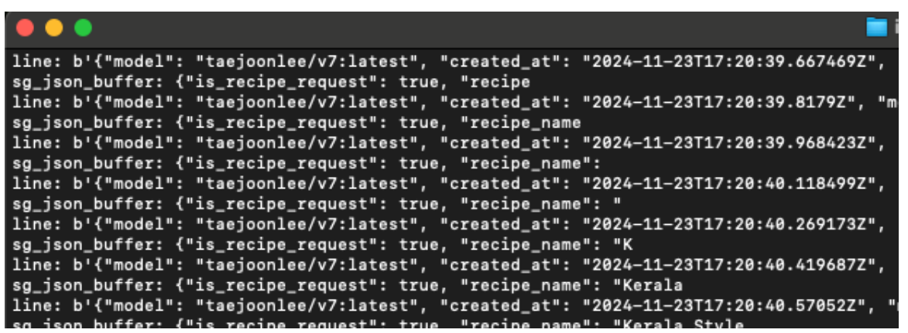
Results
(a) Enter user questions
(b) Model response results
(c) Backend Logs: Attempt to parse JSON

Slide 19
Discussion
BLEU and ROUGE are not the best metrics for creative text generation.
The scores fail to capture user experience.
Most survey respondents were satisfied with the service.
User’s input significantly impacted the quality of the model’s responses.
Providing pre-defined question examples can help users interact with models more effectively.
LLM needs to know the user’s status or knowledge level when answering their questions.
Further research and development are needed to improve the model’s performance and strengthen its user-centered approach.

Slide 20
Conclusion
Implemented an LLM-based service that can recommend creative and practical recipes based on user-input ingredients.
Fine-tuned the Llama 3 (8B) model to generate creative responses and provide additional recommendations by connecting to Google and YouTube.
Open Web UI platform was used to implement responses in real-time streaming format, enabling interactive interaction with users.
Evaluated using BLUE, ROUGE scores and user survey.
Model provided creative and realistic recipes while producing significant results on untrained data.

Slide 21
Limitation
Dataset used for training contains a limited number of recipes, around 6500.
The recipes in the dataset are biased towards the culture of the contributor .
We need to compute quantitative metrics such as BLEU and ROUGE on a large scale to better evaluate the model.
Qualitative evaluation was conducted on a small group of acquaintances.
The format of the user input also determined the quality of the model.
More testing is needed to reflect different user environments and further research is needed to consider the impact of technical limitations or network performance.

Slide 22
Future works
The model can be developed to track eating habits.
The model can be trained to make ingredient substitutions for tailored recipes according to food restrictions.
It could be developed to include multimodal capabilities.

Slide 23


